Slide 1

Chapter 12
Multicasting
And
Multicast
Routing
Protocols
TCP/IP Protocol Suite
Copyright © The McGraw-Hill Companies, Inc. Permission required for reproduction or display.

Slide 2
OBJECTIVES:
To compare and contrast unicasting, multicasting, and broadcasting communication.
To define multicast addressing space in IPv4 and show the division of the space into several blocks.
To discuss the IGMP protocol, which is responsible for collecting group membership information in a network.
To discuss the general idea behind multicast routing protocols and their division into two categories based on the creation of the shortest path trees.
To discuss multicast link state routing in general and its implementation in the Internet: a protocol named MOSPF.
TCP/IP Protocol Suite

Slide 3
OBJECTIVES (continued):
To discuss multicast distance vector routing in general and its implementation in the Internet: a protocol named DVMRP.
To discuss core-based protocol (CBT) and briefly discuss two independent multicast protocols PIM-DM and PIM-SM.
To discuss multicast backbone (MBONE) that shows how to create a tunnel when the multicast messages need to pass through an area with no multicast routers.
TCP/IP Protocol Suite

Slide 4
Chapter
Outline
12.1 Introduction
12.2 Multicast Addresses
12.3 IGMP
12.4 Multicast Routing
12.5 Routing Protocols
12.6 MBONE
TCP/IP Protocol Suite

Slide 5
12-1 INTRODUCTION
We have learned that forwarding a datagram is normally based on the prefix of the destination address in the datagram. Address aggregation mechanism may combine several datagrams to be delivered to an ISP and then separate them to be delivered to their final destination networks, but the principle does not change.
Understanding the above forwarding principle, we can now define unicasting, multicasting, and broadcasting. Let us clarify these terms as they relate to the Internet.
TCP/IP Protocol Suite

Slide 6
Topics Discussed in the Section
Unicasting
Multicasting
Broadcasting
TCP/IP Protocol Suite

Slide 7
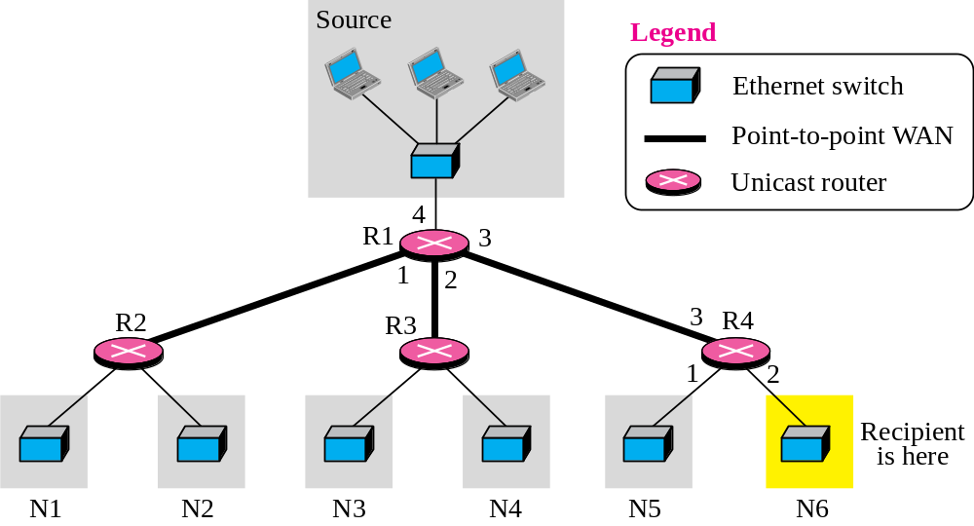
Figure 12.1 Unicasting
TCP/IP Protocol Suite

Slide 8

Note
In unicasting, the router forwards the received datagram through
only one of its interfaces.
TCP/IP Protocol Suite

Slide 9
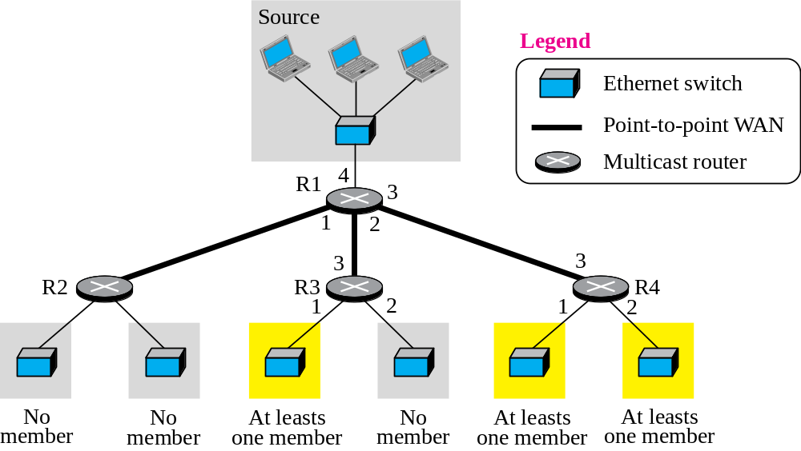
Figure 12.2 Multicasting
TCP/IP Protocol Suite

Slide 10
Note
In multicasting, the router may
forward the received datagram
through several of its interfaces.
TCP/IP Protocol Suite

Slide 11
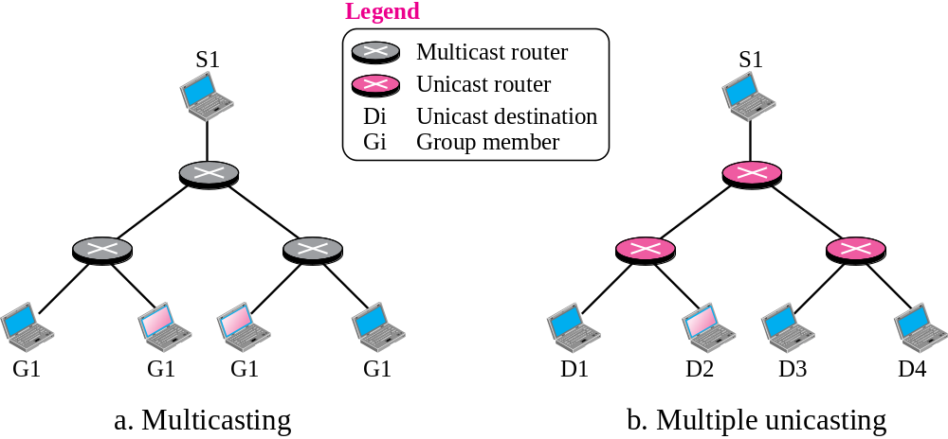


Figure 12.3 Multicasting versus multiple unicasting
TCP/IP Protocol Suite

Slide 12
Note
Emulation of multicasting through multiple unicasting is not
efficient and may create
long delays, particularly
with a large group.
TCP/IP Protocol Suite

Slide 13
12-2 MULTICAST ADDRESSES
A multicast address is a destination address for a group of hosts that have joined a multicast group. A packet that uses a multicast address as a destination can reach all members of the group unless there are some filtering restriction by the receiver.
TCP/IP Protocol Suite

Slide 14
Topics Discussed in the Section
Multicast Addresses in IPv4
Selecting Multicast Addresses
Delivery of Multicast Packets at Data Link Layer
TCP/IP Protocol Suite

Slide 15
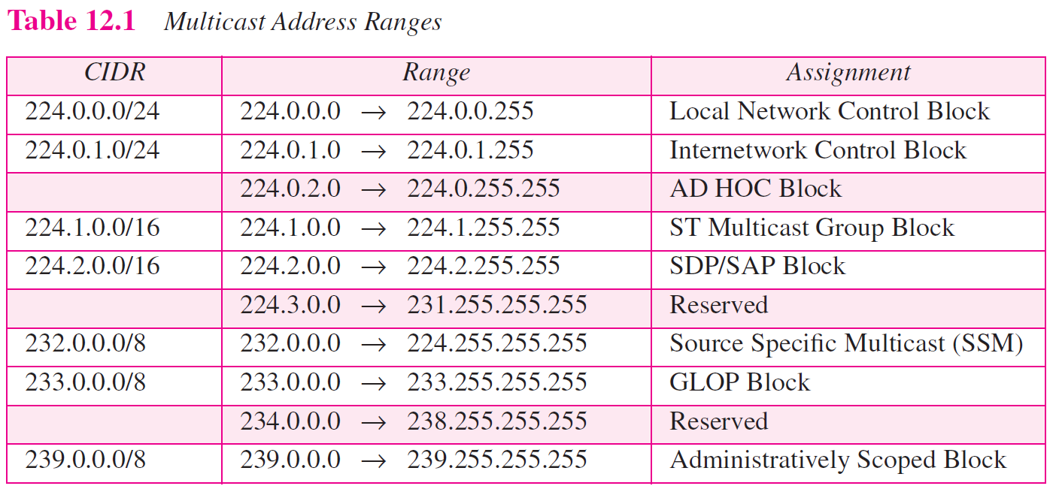
TCP/IP Protocol Suite

Slide 16
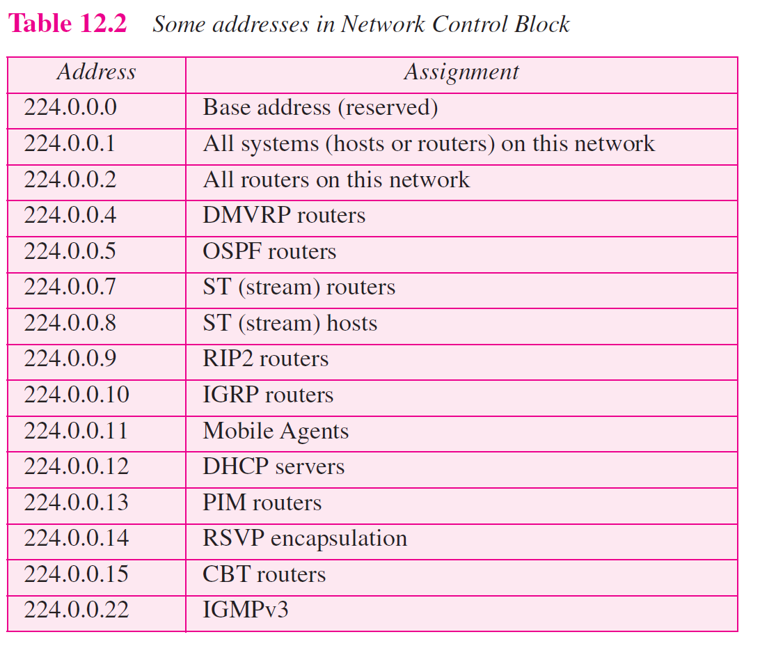
TCP/IP Protocol Suite

Slide 17
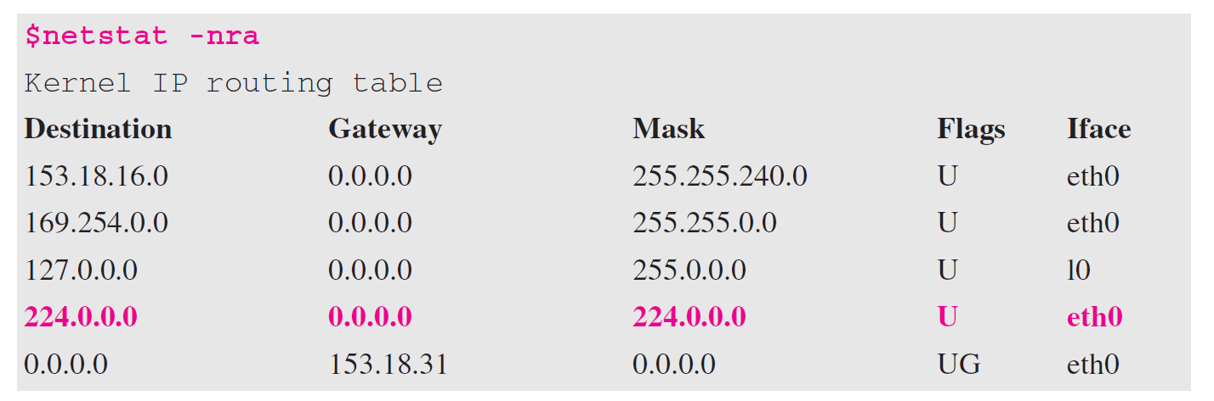
Example 12.1
We use netstat with three options, -n, -r, and -a. The -n option gives the numeric versions of IP addresses, the -r option gives the routing table, and the -a option gives all addresses (unicast and multicast). Note that we show only the fields relative to our discussion. The multicast address is shown in color.
TCP/IP Protocol Suite

Slide 18
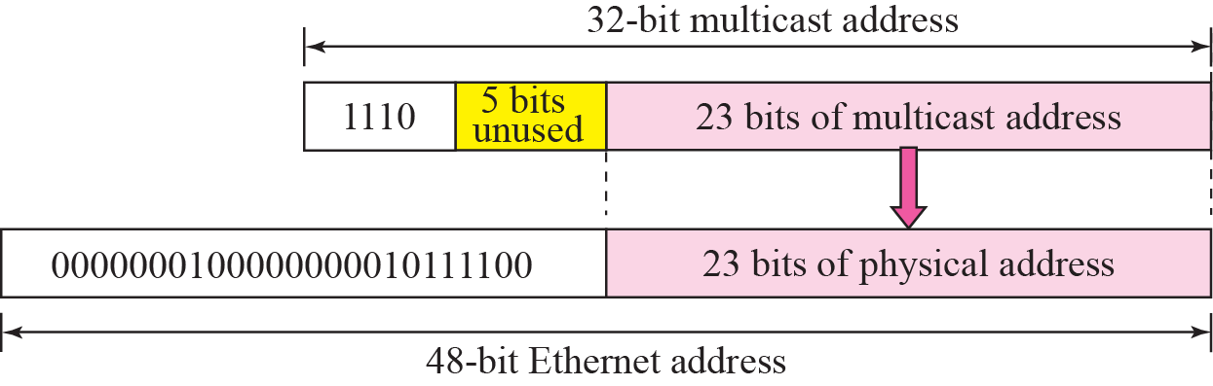
Figure 12.4 Mapping class D to Ethernet physical address
TCP/IP Protocol Suite

Slide 19
Note
An Ethernet multicast physical
address is in the range
01:00:5E:00:00:00
to
01:00:5E:7F:FF:FF.
TCP/IP Protocol Suite

Slide 20
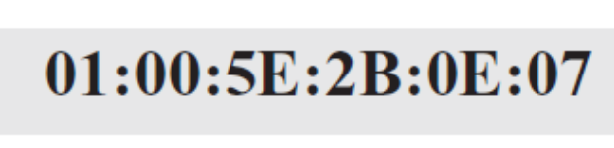
Example 12.2
Change the multicast IP address 232.43.14.7 to an Ethernet multicast physical address.
Solution
We can do this in two steps:
a. We write the rightmost 23 bits of the IP address in
hexadecimal. This can be done by changing the rightmost 3 bytes to hexadecimal and then subtracting 8 from the leftmost digit if it is greater than or equal to 8. In our example the result is 2B:0E:07.
b. We add the result of part a to the starting Ethernet multicast address, which is 01:00:5E:00:00:00. The result is
TCP/IP Protocol Suite

Slide 21
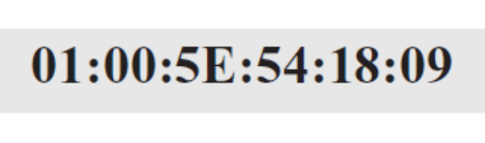
Example 12.3
Change the multicast IP address 238.212.24.9 to an Ethernet multicast address.
Solution
We can do this in two steps:
a. The rightmost 3 bytes in hexadecimal are D4:18:09. We need to subtract 8 from the leftmost digit, resulting in 54:18:09.
b. We add the result of part a to the Ethernet multicast starting address. The result is
TCP/IP Protocol Suite

Slide 22
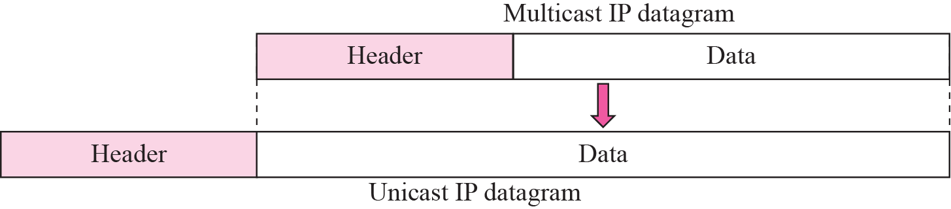
Figure 12.5 Tunneling
TCP/IP Protocol Suite

Slide 23
12-3 IGMP
Multicast communication means that a sender sends a message to a group of recipients that are members of the same group. Each multicast router needs to know the list of groups that have at least one loyal member related to each interface. Collection of this type of information is done at two levels: locally and globally. The first task is done by the IGMP protocol; the second task is done by the multicast routing protocols.
TCP/IP Protocol Suite

Slide 24
Topics Discussed in the Section
Group Management
IGMP Messages
IGMP Protocol Applied to host
IGMP Protocol Applied to Router
Role of IGMP in Forwarding
Variables and Timers
Encapsulation
Compatibility with other Versions
TCP/IP Protocol Suite

Slide 25
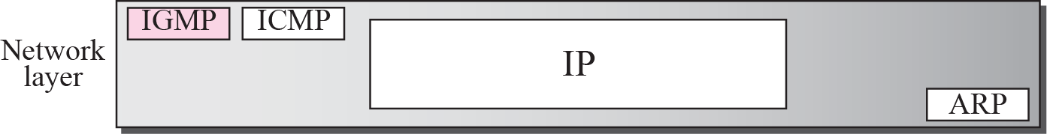
Figure 12.6 Position of IGMP in the network layer
TCP/IP Protocol Suite

Slide 26
Note
IGMP is a group management protocol. It helps a multicast router create and update a list of loyal members related
to each router interface.
TCP/IP Protocol Suite

Slide 27
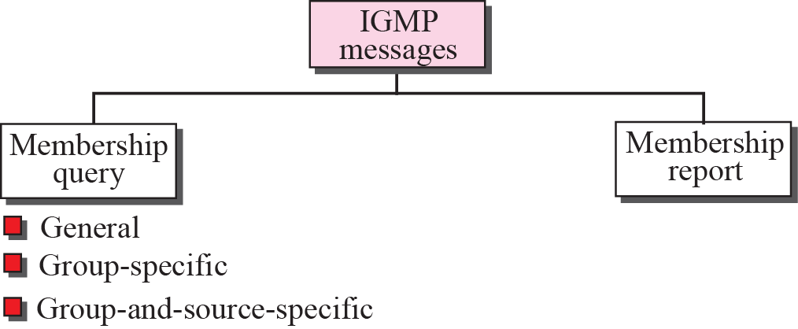
Figure 12.7 IGMP messages
TCP/IP Protocol Suite

Slide 28
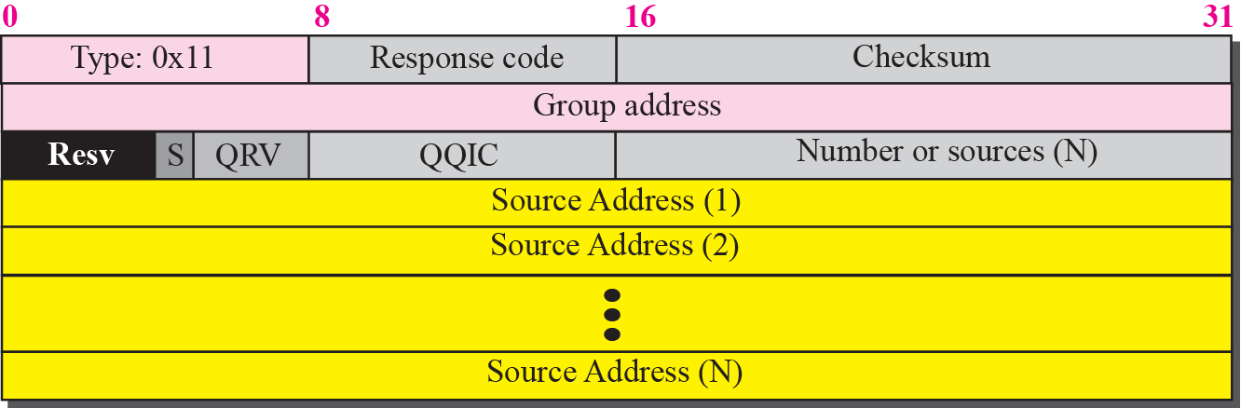
Figure 12.8 Membership query message format
TCP/IP Protocol Suite

Slide 29
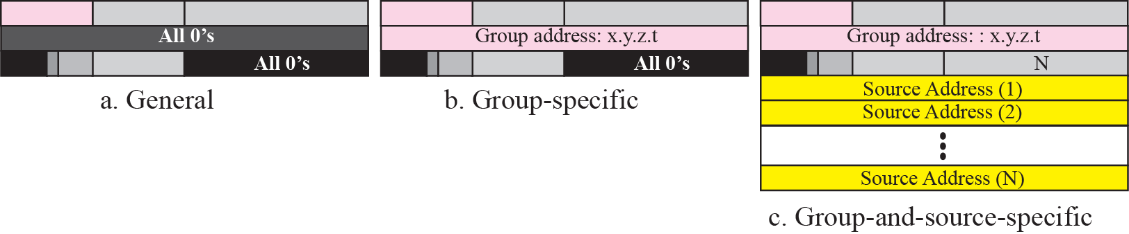
Figure 12.9 Three forms of query messages
TCP/IP Protocol Suite

Slide 30
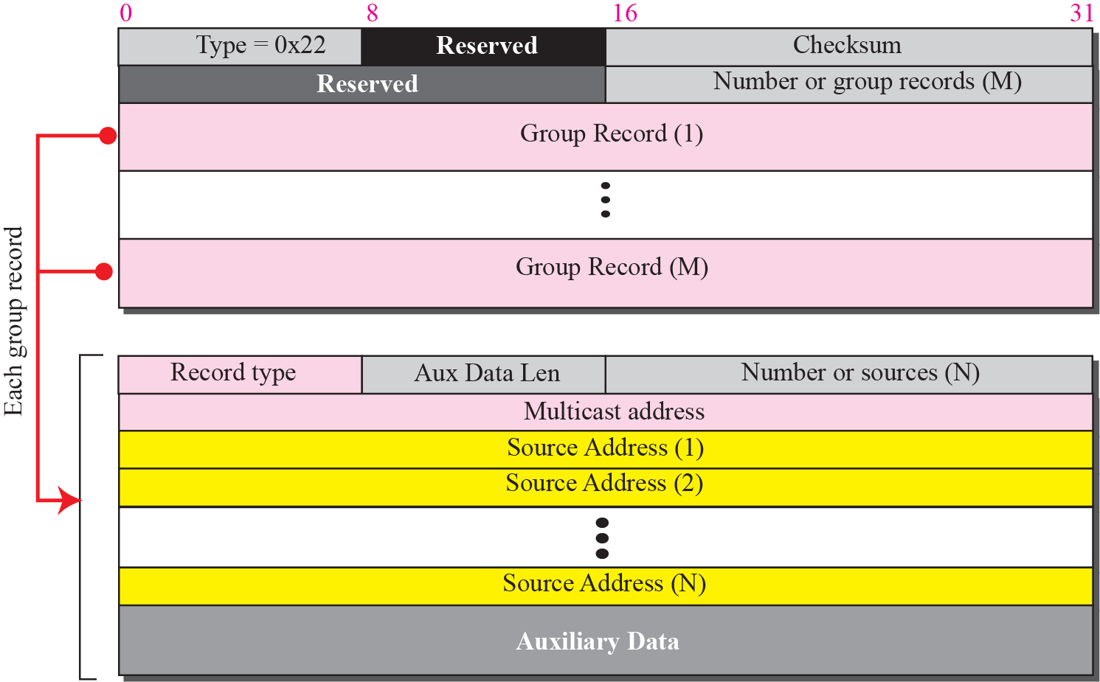
Figure 12.10 Membership report message format
TCP/IP Protocol Suite

Slide 31
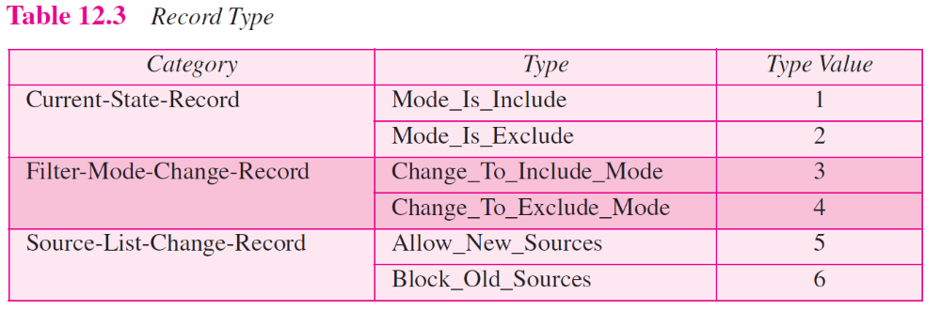
TCP/IP Protocol Suite

Slide 32
Example 12.4
Figure 12.11 shows a host with three processes: S1, S2, and S3. The first process has only one record; the second and the third processes each have two records. We have used lowercase alphabet to show the source address.
TCP/IP Protocol Suite

Slide 33
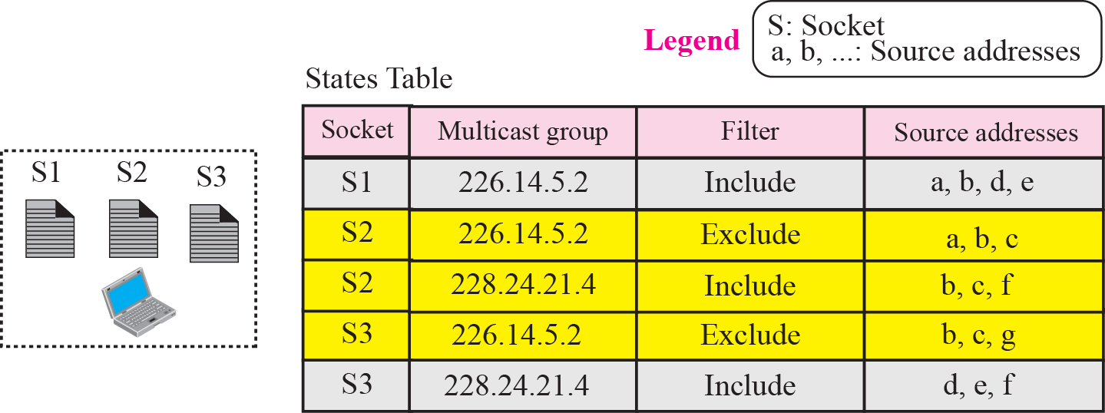
Figure 12.11 Socket state
TCP/IP Protocol Suite

Slide 34
Note
Each time there is a change in any socket record, the interface state
will change using the
above-mentioned rules.
TCP/IP Protocol Suite

Slide 35
Example 12.5
We use the two rules described above to create the interface state for the host in Example 12.4. First we found the list of source address for each multicast group.
a. Multicast group 226.14.5.2 has two exclude lists and one include list. The result is an exclude list as calculated below.
b. Multicast group: 228.24.21.4 has two include lists. The result is an include list as calculated below. We use the plus sign for the union operation.
Figure 12.12 shows the interface state.
TCP/IP Protocol Suite

Slide 36
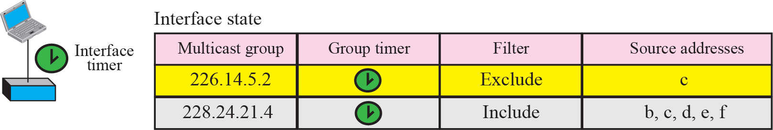
Figure 12.12 Interface state
For delaying response to queries (Report Suppression)
TCP/IP Protocol Suite

Slide 37
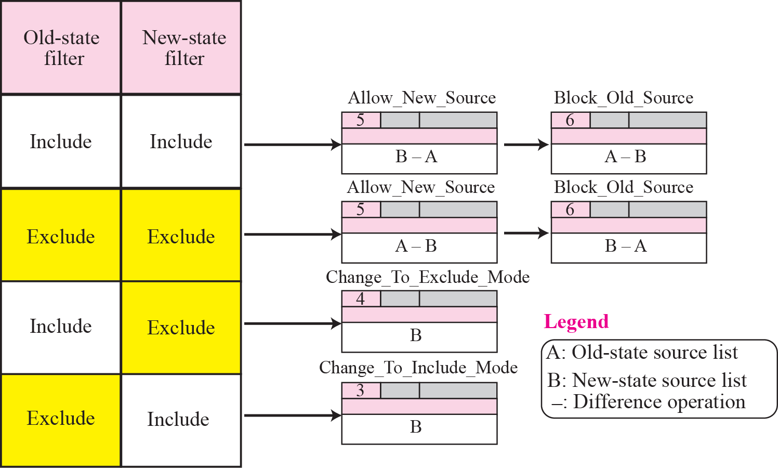
Figure 12.13 Sending change state reports
TCP/IP Protocol Suite

Slide 38
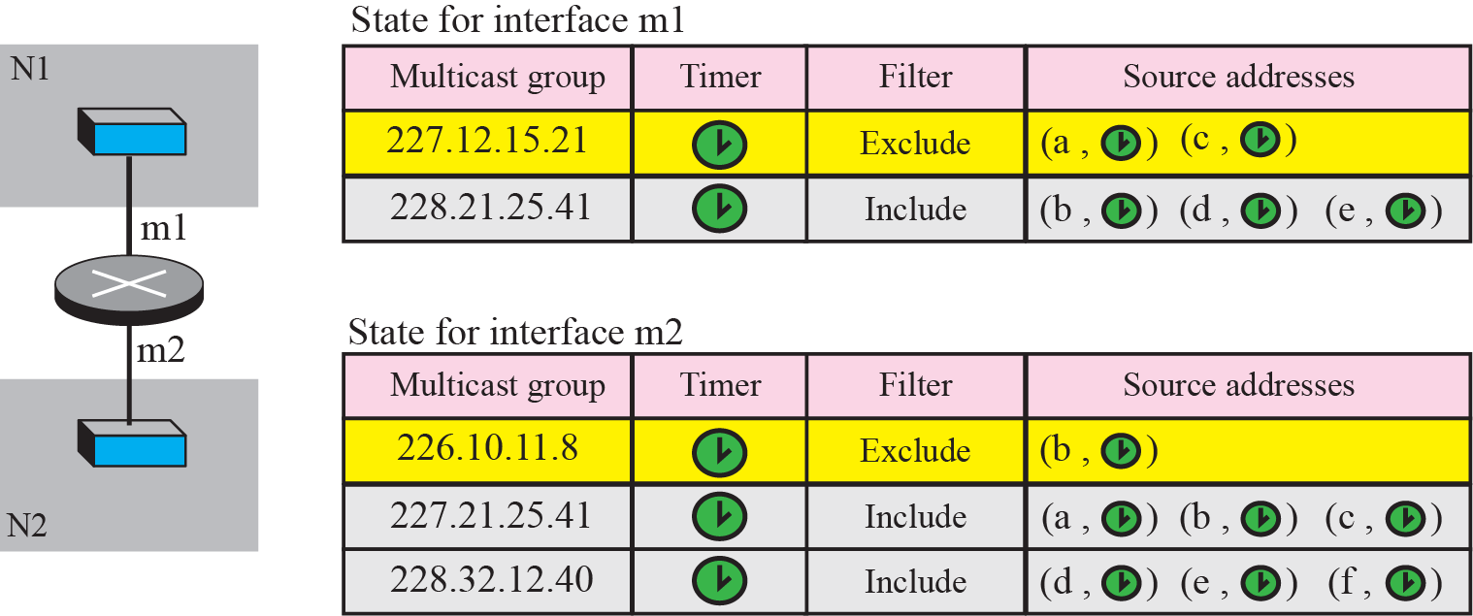
Figure 12.14 Router States
For sending corresponding queries
TCP/IP Protocol Suite

Slide 39
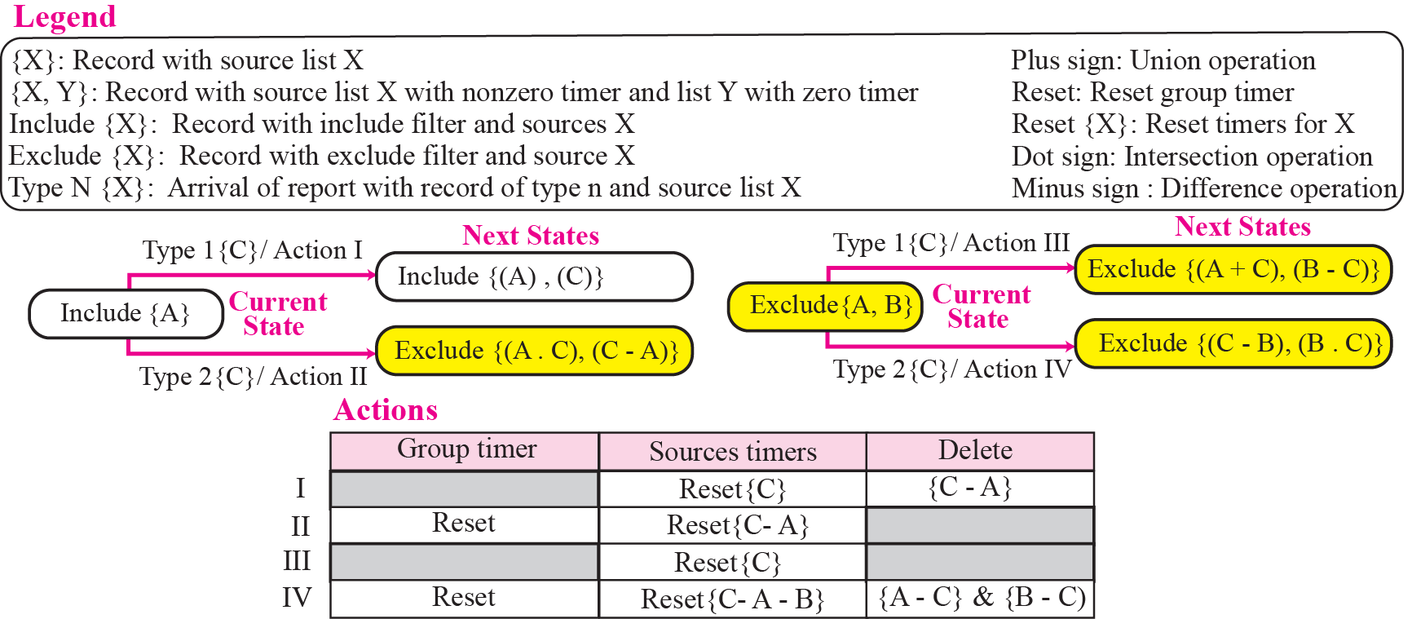
Figure 12.15 Change of state related to general query report
TCP/IP Protocol Suite

Slide 40
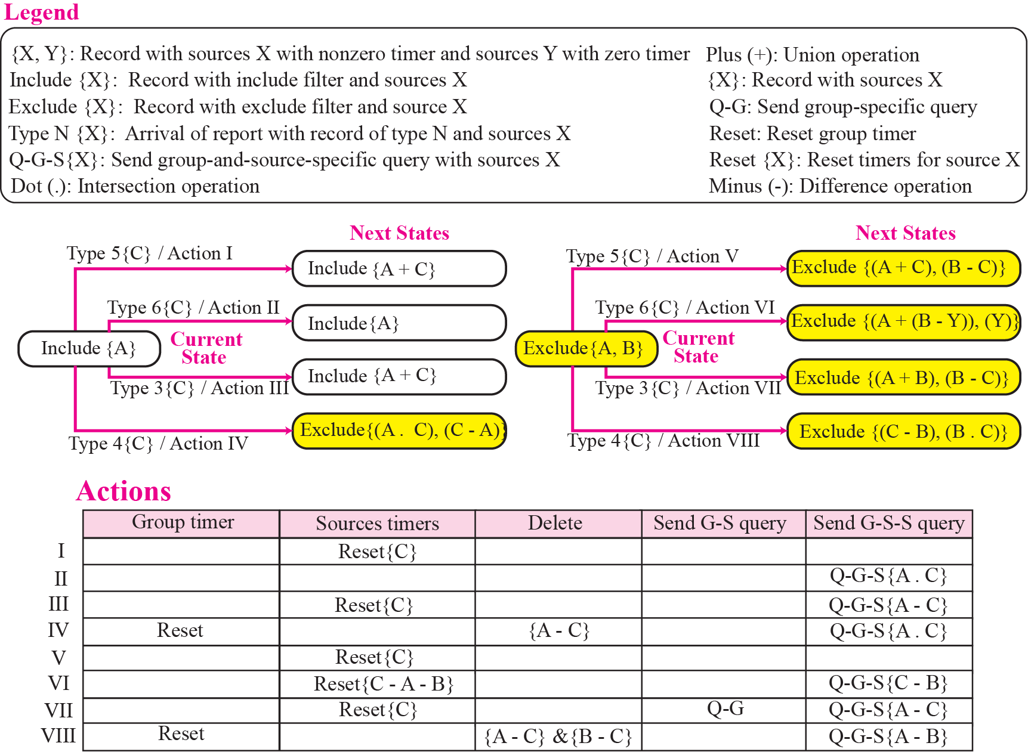
Figure 12.16 Change of state related to other report types
TCP/IP Protocol Suite

Slide 41
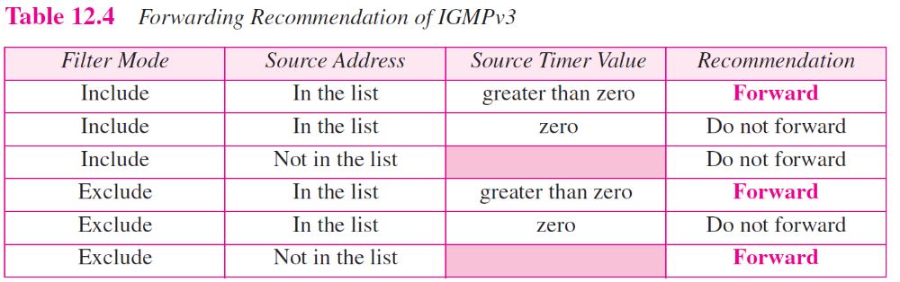
TCP/IP Protocol Suite

Slide 42
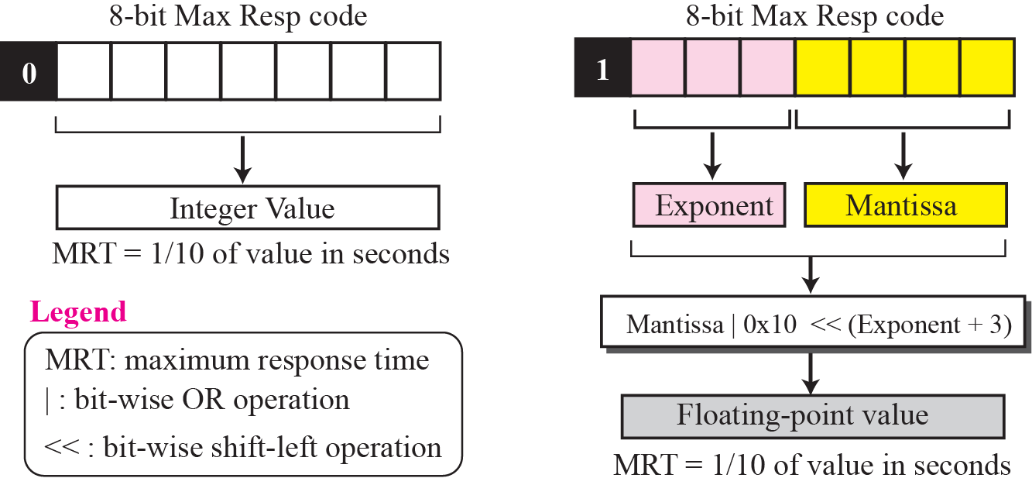
Figure 12.17 Calculation of maximum response time
TCP/IP Protocol Suite

Slide 43
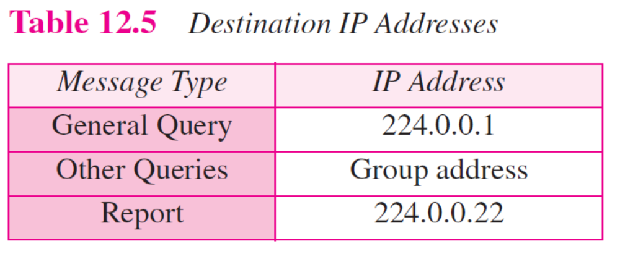
TCP/IP Protocol Suite

Slide 44
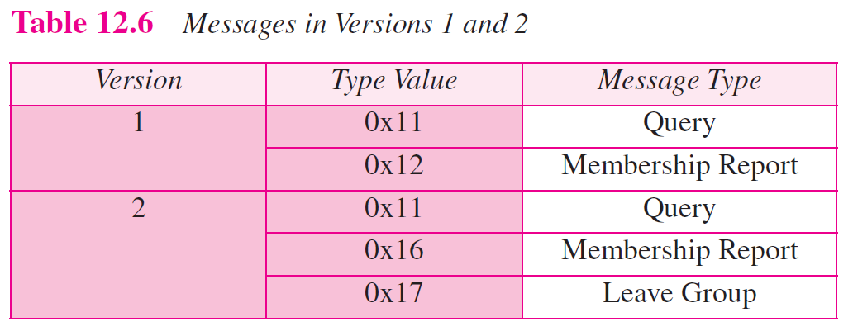
TCP/IP Protocol Suite

Slide 45
12-4 MULTICAST ROUTING
Now we show how information collected by IGMP is disseminated to other routers using multicast routing protocols. However, we first discuss the idea of optimal routing, common in all multicast protocols. We then give an overview of multicast routing protocols.
TCP/IP Protocol Suite

Slide 46
Topics Discussed in the Section
Optimal Routing: Shortest Path Trees
TCP/IP Protocol Suite

Slide 47
Note
In unicast routing, each router in the domain has a table that defines a shortest path tree to possible destinations.
TCP/IP Protocol Suite

Slide 48
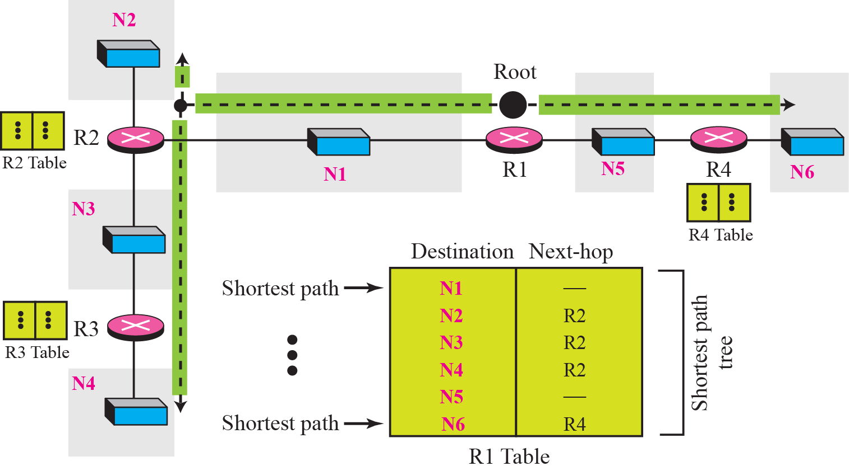
Figure 12.18 Shortest path tree in multicast routing
TCP/IP Protocol Suite

Slide 49
Note
In multicast routing, each involved router needs to construct a shortest
path tree for each group.
TCP/IP Protocol Suite

Slide 50
Note
In the source-based tree approach, each router needs to have one shortest path tree for each group and source.
TCP/IP Protocol Suite

Slide 51
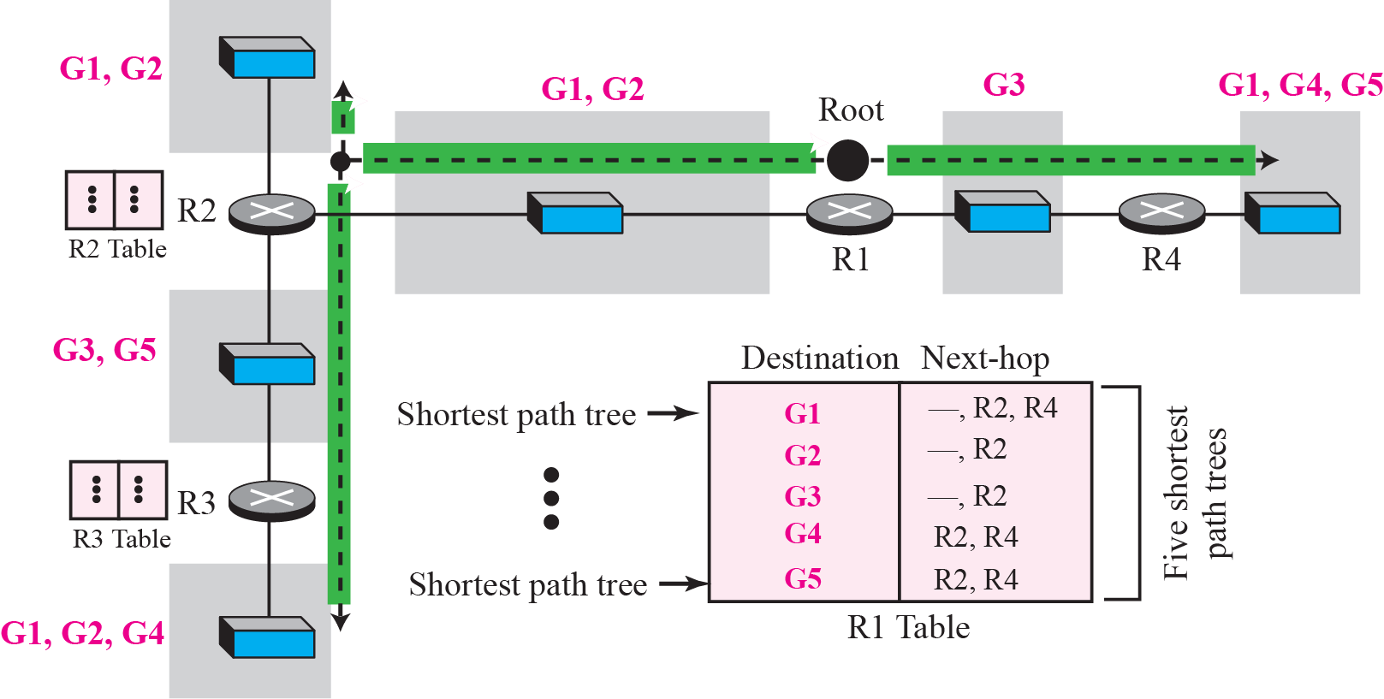
Figure 12.19 Source-based tree approach
注意：課本中此段的文字敘述有問題，請參考網頁的參考資料。
TCP/IP Protocol Suite

Slide 52
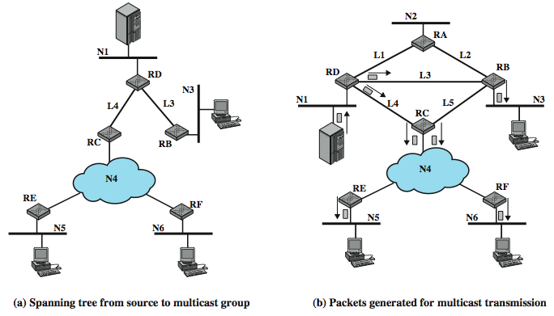
E.g. Source-based Tree (1)
TCP/IP Protocol Suite

Slide 53
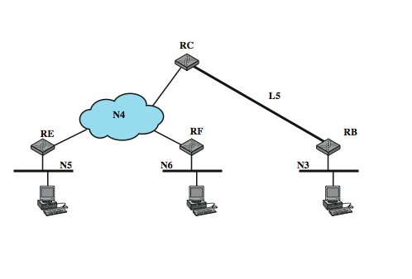
E.g. Source-based Tree (2)
Spanning Tree from Router C to Multicast Group
TCP/IP Protocol Suite

Slide 54
Note
In the group-shared tree approach, only the core router, which has a shortest path tree for each group, is involved
in multicasting.
TCP/IP Protocol Suite

Slide 55
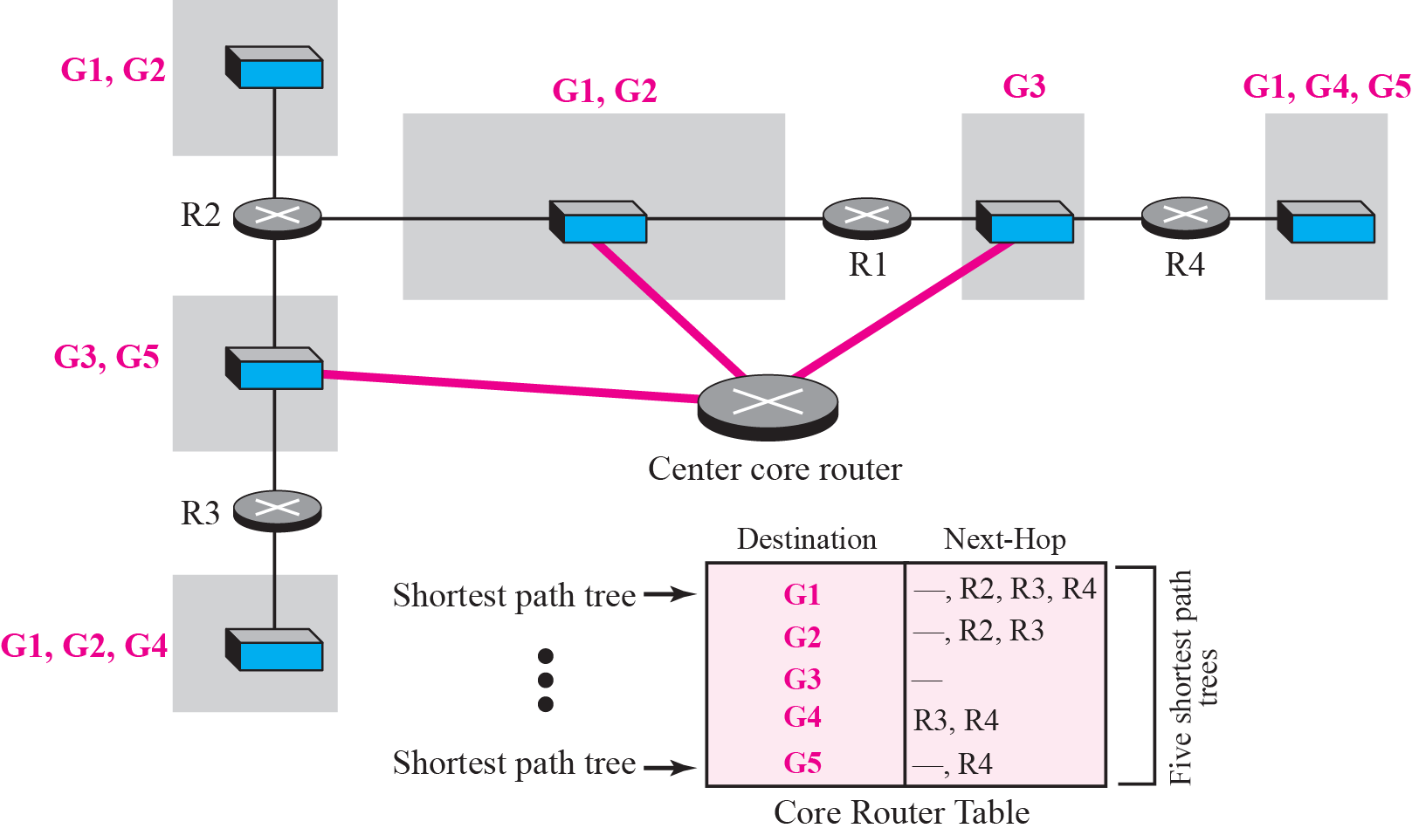
Figure 12.20 Group-shared tree approach
TCP/IP Protocol Suite

Slide 56
Group-Shared Tree
If a router receives a multicast packet, it encapsulates the packet in a unicast packet and sends it to the core router
The core router removes the multicast packet from its capsule, and consults its routing table to route the packet
TCP/IP Protocol Suite

Slide 57
12-4 ROUTING PROTOCOLS
During the last few decades, several multicast routing protocols have emerged. Some of these protocols are extensions of unicast routing protocols; some are totally new. We discuss these protocols in the remainder of this chapter. Figure 12.21 shows the taxonomy of these protocols.
TCP/IP Protocol Suite

Slide 58
Topics Discussed in the Section
Multicast Link State Routing: MOSPF
Multicast Distance Vector: DVMRP
Core-Based Tree: CBT
Protocol Independent Multicast: PIM
TCP/IP Protocol Suite

Slide 59
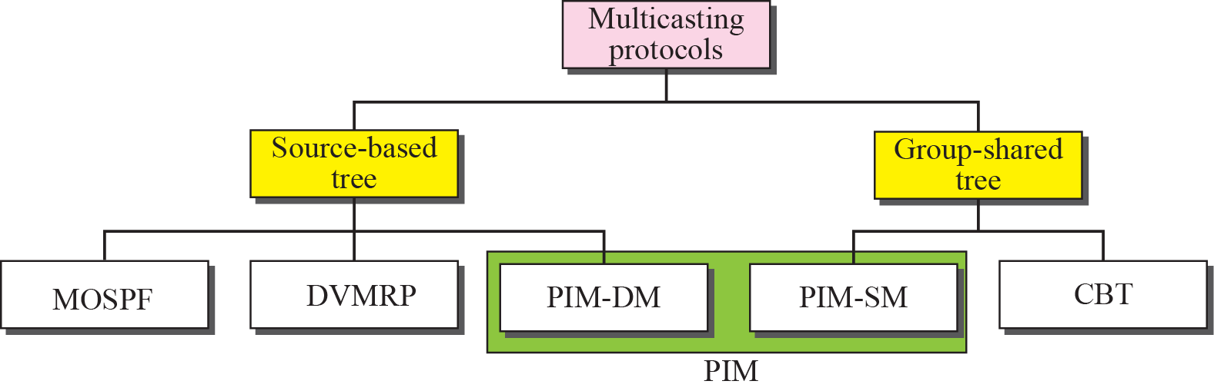
Figure 12.21 Taxonomy of common multicast protocols
TCP/IP Protocol Suite

Slide 60
Note
Multicast link state routing uses the source-based tree approach.
TCP/IP Protocol Suite

Slide 61
MOSPF (1)
Group membership LSA is flooded throughout the AS
The router calculates the shortest path trees on demand (when it receives the first multicast packet)
MOSPF is a data-driven protocol; the first time an MOSPF router see a datagram with a given source and group address, the router constructs the Dijkstra shortest path tree
TCP/IP Protocol Suite

Slide 62
MOSPF (2)
The shortest path tree is made all at once instead of gradually (i.e. pre-made, pre-pruned, ready to use)
TCP/IP Protocol Suite

Slide 63
MOSPF with Areas (1)
Group management
  Group-membership LSA is flooded in the same area.
  Inter-area multicast forwarders (area border routers) summarize their attached areas' group membership to the backbone.
Data routing
  Introduction of the wild-card multicast receivers (area border routers)
TCP/IP Protocol Suite

Slide 64
MOSPF with Areas (2)
Data routing (cont)
  In the presence of OSPF areas, during tree pruning care must be taken so that the branches leading to other areas remain, since it is unknown whether there are group members in these (remote) areas.
  For this reason, only those branches having no group members nor wild-card multicast receivers are pruned when producing the datagram shortest-path tree.
TCP/IP Protocol Suite

Slide 65
MOSPF with Areas (3)
Data routing (cont)
  1. Source area: building intra-area shortest path tree (forward cost) with leaf nodes including wild-card multicast receivers.
  2. Backbone area: each wild-card multicast receiver of the source area calculates the shortest path from the source to the multicast forwarders (with group members) of other areas using the reverse cost.
  (You must know the reason why using the reverse cost in this case)
TCP/IP Protocol Suite

Slide 66
MOSPF with Areas (4)
Data routing (cont)
  E.g. In Figure 4 of the sample MOSPF area configuration in the supplementary document, RT3 and RT4 can calculate and compare to determine which one of them should construct the shortest path from the source to RT7, RT10, and RT11 (the multicast forwarders in non-source areas). The result tree is shown in Figure 9 in the supplementary document.
TCP/IP Protocol Suite

Slide 67
MOSPF with Areas (5)
Data routing (cont)
  3. Destination areas: The corresponding multicast forwarder (e.g. RT7 in area 2) constructs the shortest path using the reverse cost to each network (with group members) in its own area.
TCP/IP Protocol Suite

Slide 68
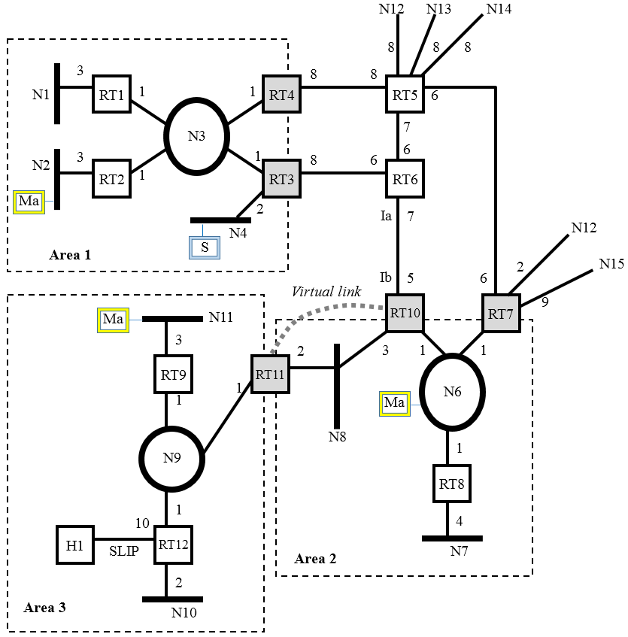

Slide 69
MOSPF Tree in Source Area
Area 1
RT3
(origin=N4)
(wild card)
1
N3
0
0
RT2
RT4
(wild card)
(N2, Ma)
TCP/IP Protocol Suite

Slide 70
MOSPF Tree in Backbone Area
N4
(origin)
2
3
RT3
RT4
(wild card)
6
8
RT6
RT5
5
6
(wild card)
RT10
RT7
(wild card)
2
RT11
(wild card)
TCP/IP Protocol Suite

Slide 71
MOSPF Tree in Destination Area
Area 3
Area 2
(origin)
(origin)
N4
N4
15
15
13
17
(wild card)
RT11
RT11
RT10
RT7
1
(wild card)
(wild card)
(wild card)
(Ma, N6)
RT9
(Ma, N11)
TCP/IP Protocol Suite

Slide 72
Multicast Distance Vector Routing
4 decision-making strategies
1. Flooding
2. Reverse Path Forwarding (RPF)
3. Reverse Path Broadcasting (RPB)
4. Reverse Path Multicasting (RPM)
TCP/IP Protocol Suite

Slide 73
Note
Flooding broadcasts packets, but creates loops in the systems.
TCP/IP Protocol Suite

Slide 74
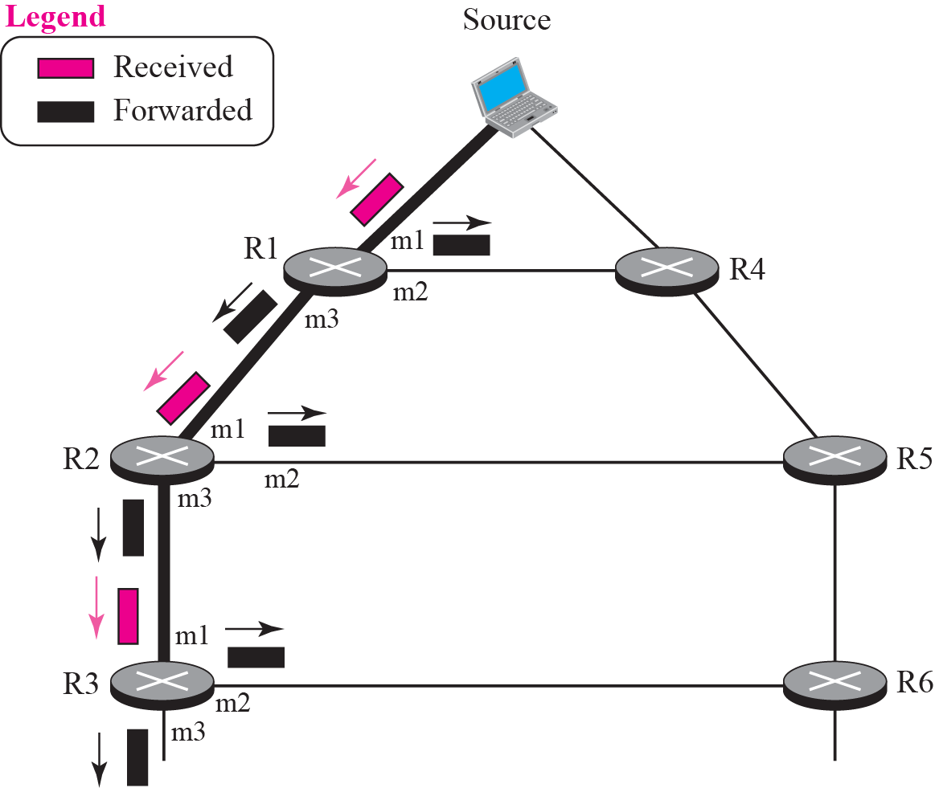
Figure 12.22 RPF
TCP/IP Protocol Suite

Slide 75
Reverse Path Forwarding (1)
To prevent loops, only one copy is forwarded; the other copies are dropped.
In RPF, a router forwards only the copy that has traveled the shortest path from the source to the router.
The router extracts the source address of the multicast packet and consults its unicast routing table.
TCP/IP Protocol Suite

Slide 76
Reverse Path Forwarding (2)
If the packet has just come from the hop defined in the table, the packet has traveled the shortest path from the source to the router because the shortest path is reciprocal in unicast distance vector routing protocols.
If a packet leaves the router and comes back again, it has not traveled the shortest path.
TCP/IP Protocol Suite

Slide 77
Note
RPF eliminates the loop in the
flooding process.
TCP/IP Protocol Suite

Slide 78
E.g. No Loops in RPF
Src
Shortest Path
HC=L+2
R0
Shortest Path
HC=L
R1
R2
Shortest Path
HC=L+1
TCP/IP Protocol Suite

Slide 79
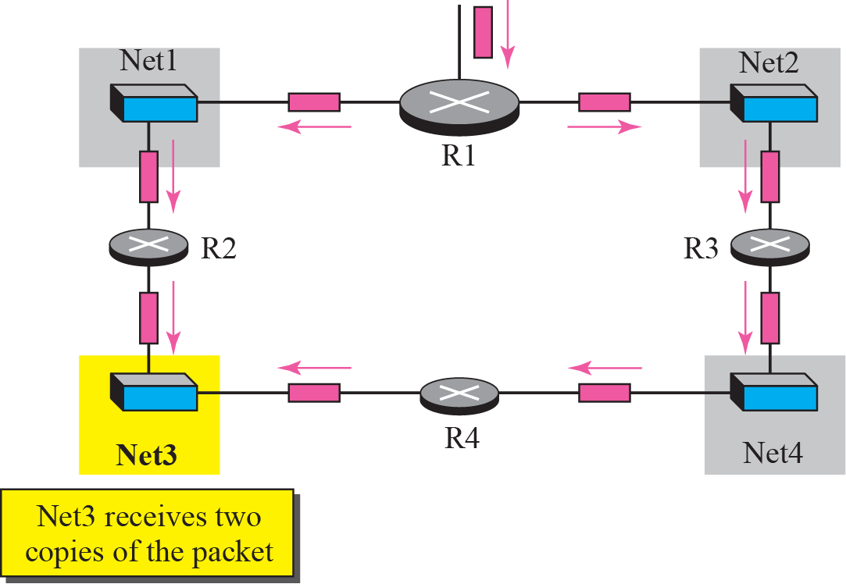
Figure 12.23 Problem with RPF
TCP/IP Protocol Suite

Slide 80
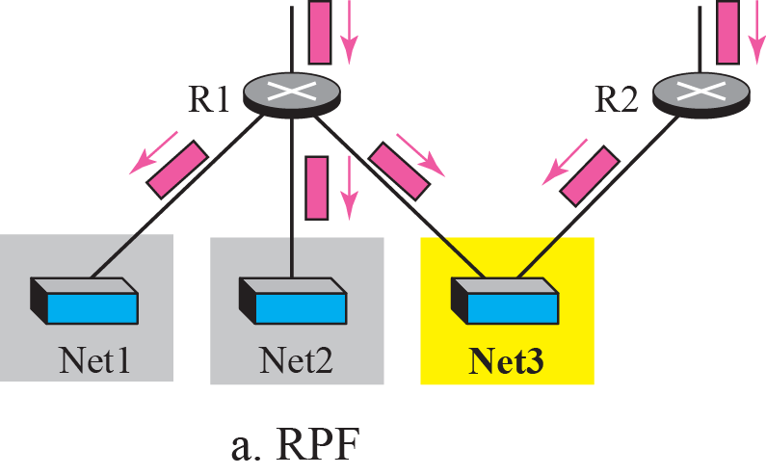
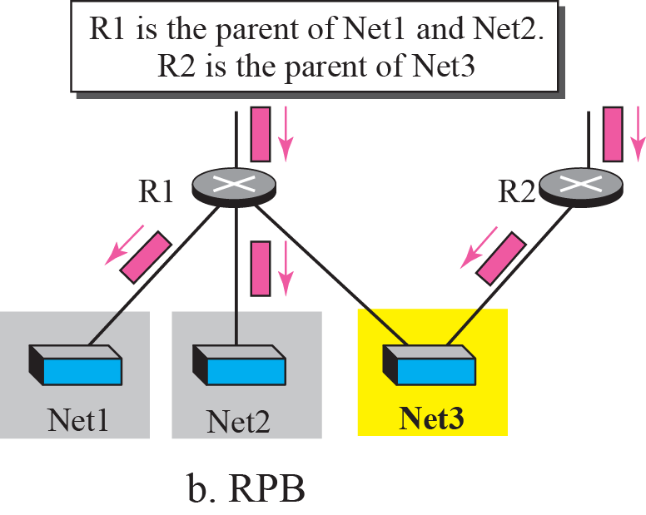
Figure 12.24 RPF versus RPB
TCP/IP Protocol Suite

Slide 81
Reverse Path Broadcasting (1)
RPF guarantees that each network receives a copy of the multicast packet without formation of loops
However, RPF does not guarantee that each network receives only one copy
To eliminate duplication, we must define only one parent router (designated parent router) for each network
TCP/IP Protocol Suite

Slide 82
Reverse Path Broadcasting (2)
In RPB, for each source, the router sends the packet only out of those interfaces for which it is the designated parent
The designated parent router can be the router with the shortest path to the source
  Because routers periodically send updating packets to each other (in RIP), they can easily determine which router in the neighborhood has the shortest path to the source.
TCP/IP Protocol Suite

Slide 83
Note
RPB creates a shortest path broadcast tree from the source to each destination.
It guarantees that each destination receives one and only one copy
of the packet.
TCP/IP Protocol Suite

Slide 84
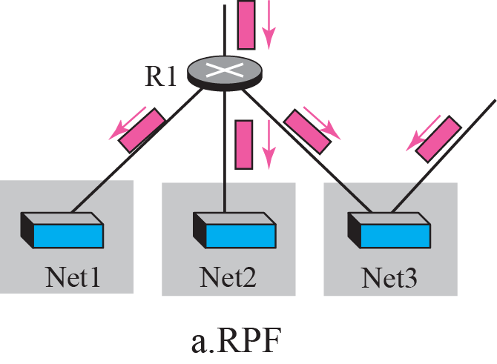
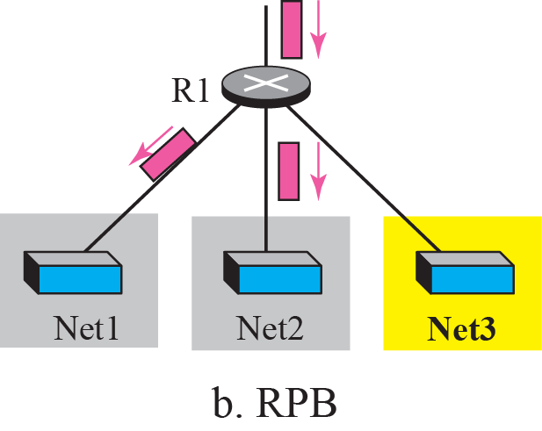
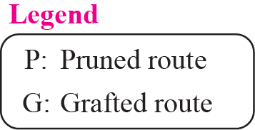
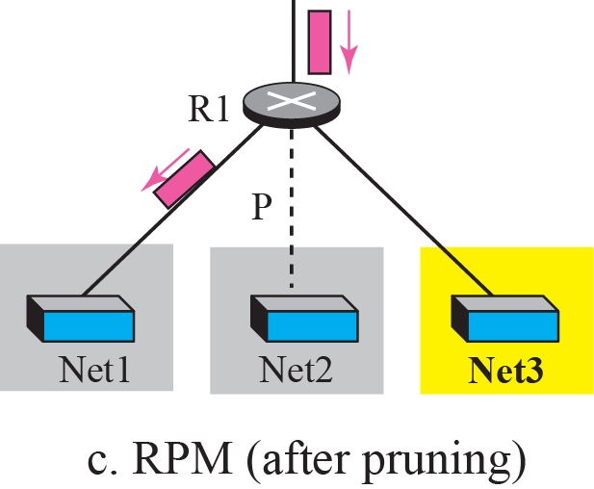
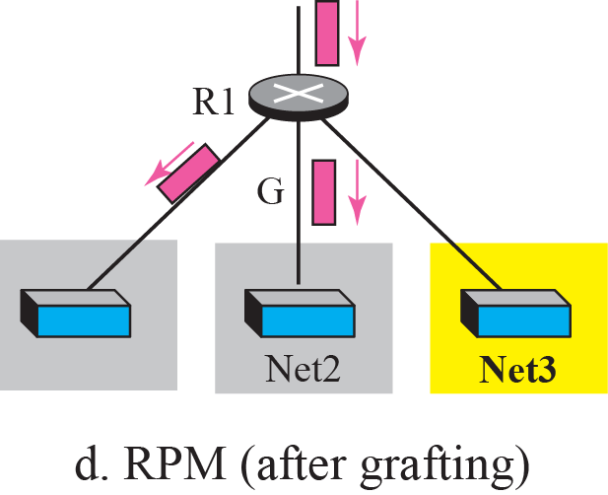
Figure 12.25 RPF, RPB, and RPM
(Src, Group ID)
(Src, Group ID)
TCP/IP Protocol Suite

Slide 85
Reverse Path Multicasting (1)
To increase efficiency, the multicast packet must reach only those networks that have active members for that particular group
RPM adopts the procedures of Pruning and Grafting
Pruning
  The designated parent router of each network is responsible for holding the membership information (through IGMP)
TCP/IP Protocol Suite

Slide 86
Reverse Path Multicasting (2)
  The router sends a prune message to the upstream router so that it can prune the corresponding interface
  That is, the upstream router can stop sending multicast message for this group through that interface
Grafting
  The graft message forces the upstream router to resume sending the multicast messages
TCP/IP Protocol Suite

Slide 87
Note
RPM adds pruning and grafting to RPB to create a multicast shortest path tree that supports dynamic membership changes.
TCP/IP Protocol Suite

Slide 88
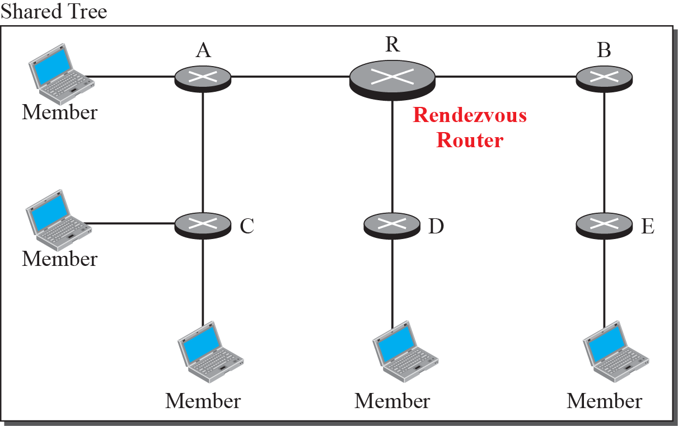
Figure 12.26 Group-shared tree with rendezvous router
TCP/IP Protocol Suite

Slide 89
Formation of CBT tree (1)
After the rendezvous point is selected, every router is informed of the unicast address of the selected router
Each router sends a unicast join message to show that it wants to join the group
This message passes through all routers that are located between the sender and the rendezvous router
TCP/IP Protocol Suite

Slide 90
Formation of CBT tree (2)
Each intermediate router extracts the necessary information from the message
  Unicast address of the sender
  Interface through which the packet has arrived
Every router knows its upstream router and the downstream router
If a router wants to leave the group, it sends a leave message to its upstream router, …
TCP/IP Protocol Suite

Slide 91
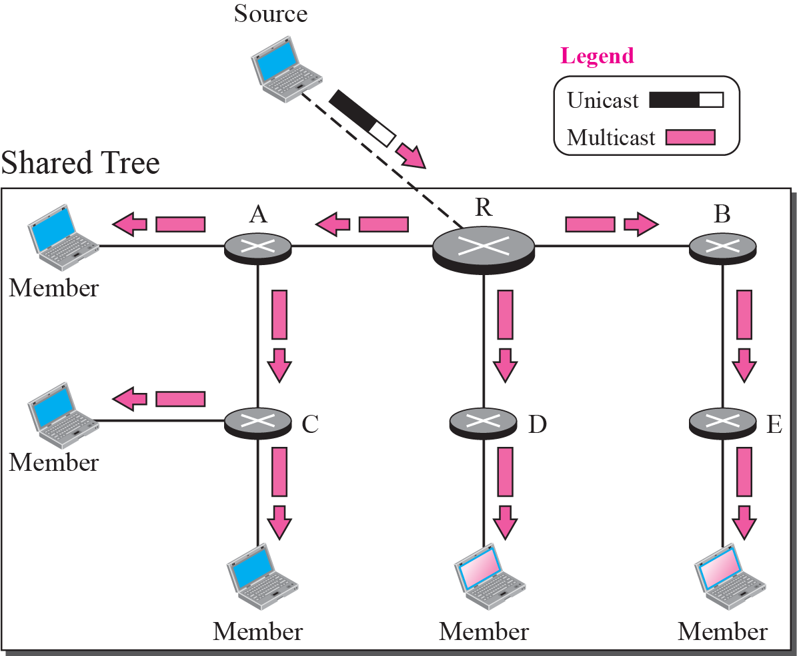
Figure 12.27 Sending a multicast packet to the rendezvous router
TCP/IP Protocol Suite

Slide 92
Note
In CBT, the source sends the multicast packet (encapsulated in a unicast packet) to the core router. The core router decapsulates the packet and forwards it to all interested
interfaces.
TCP/IP Protocol Suite

Slide 93
Comparisons
The tree for DVMRP and MOSPF is made from the root up
The tree for CBT is formed from the leaves down
In DVMRP, the tree is first made (broadcasting) and then pruned
In CBT, the joining gradually makes the tree, and the source in CBT may or may not be part of the tree
TCP/IP Protocol Suite

Slide 94
Note
PIM-DM is used in a dense multicast environment, such as a LAN.
TCP/IP Protocol Suite

Slide 95
PIM-DM
It is used when there is a possibility that each router is involved in multicasting (dense mode)
In this environment, the use of a protocol that broadcasts the packet is justified because almost all routers are involved in the process
TCP/IP Protocol Suite

Slide 96
Note
PIM-DM uses RPF and pruning/grafting strategies to handle multicasting.
However, it is independent from the underlying unicast protocol.
TCP/IP Protocol Suite

Slide 97
Note
PIM-SM is used in a sparse multicast environment such as a WAN.
TCP/IP Protocol Suite

Slide 98
Note
PIM-SM is similar to CBT but uses a simpler procedure.
TCP/IP Protocol Suite

Slide 99
12-6 MBONE
Multimedia and real-time communication have increased the need for multicasting in the Internet. However, only a small fraction of Internet routers are multicast routers. Although this problem may be solved in the next few years by adding more and more multicast routers, there is another solution for this problem. The solution is tunneling. The multicast routers are seen as a group of routers on top of unicast routers. The multicast routers may not be connected directly, but they are connected logically.
TCP/IP Protocol Suite

Slide 100
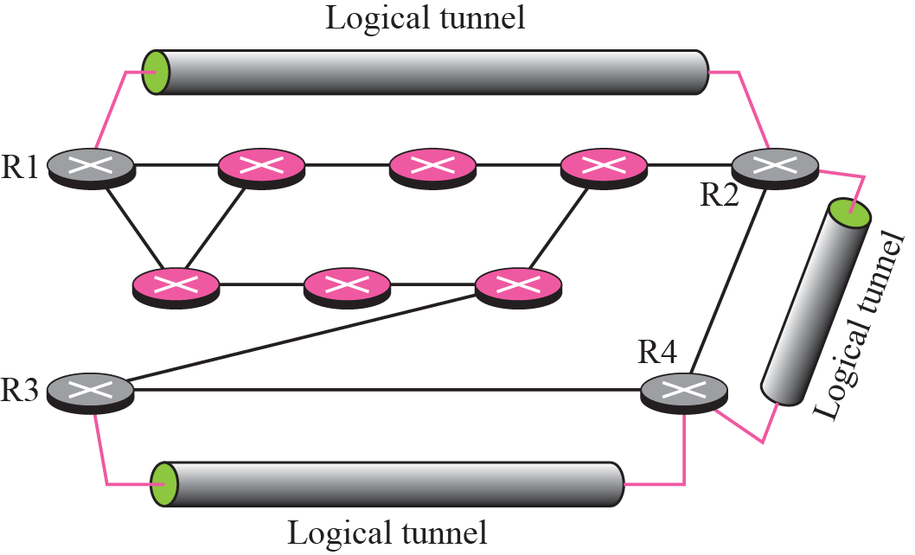
Figure 12.28 Logical tunneling
TCP/IP Protocol Suite

Slide 101
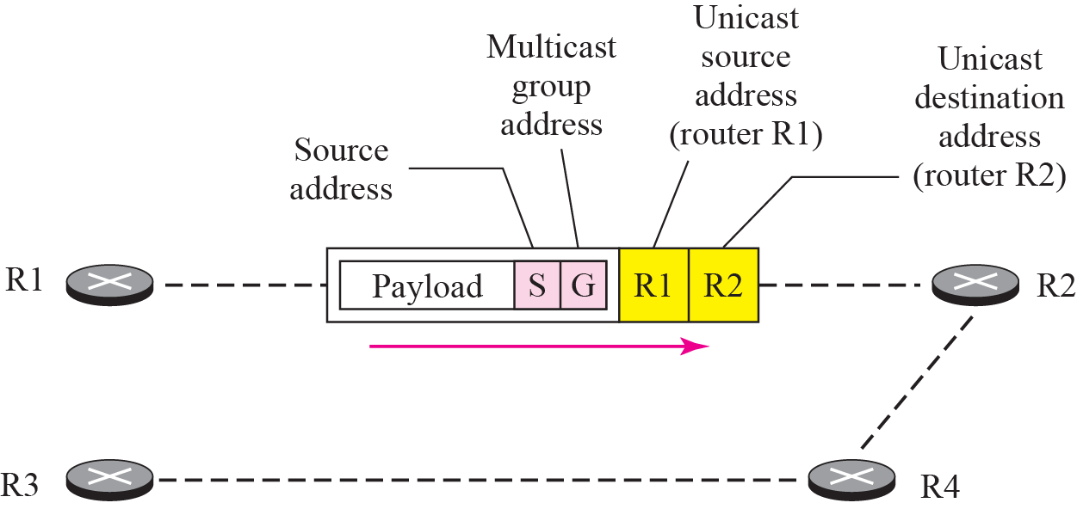
Figure 12.29 MBONE
TCP/IP Protocol Suite

